Slide 1
Programme
Inclusive Wellbeing Summit
‘Menopause Support for All Genders’
Friday 31 May 2024 (9am to 4pm)
Salisbury District Hospital
Lecture Theatre
Education Centre
5th Floor
Salisbury
SP2 8BJ
Programme QR

Slide 2
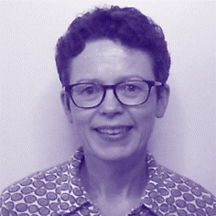
Welcome
Salisbury NHS Foundation trust (SFT) is pleased to invite you to its first summit on Menopause. We hope that you will enjoy the day and gain insights into an important area that SFT wants to support so that all staff can come to work as their best selves in a compassionate and inclusive work environment.
Foreword
As you will hear from some of our speakers, perimenopause is a serious workplace issue* and leads to the loss of highly experienced staff from the NHS each year, including here at SFT. The UK is leading the way in advocating perimenopause support in the workplace and the summit will introduce you to some of the ways this is being rolled out.
SFT is keen to ensure that support is available for all staff no matter what their gender or cultural background and we have aimed to create a day which includes information to help those going through perimenopause but also for staff who are supporting individuals going through it.
Everyone will know someone who goes through it at some point in their life, be that a colleague, partner, family member or friend.
Another aim has been to inform younger people who will go through perimenopause so they are better prepared and have some tips for actions they can take now to help lessen some of the symptoms when they reach this stage.
We hope that you find the sessions helpful and informative and come away with some ideas to make your life and those you support easier, and SFT a more supportive workplace for all perimenopausal staff going forward.
* Menopause in the workplace (2023) Available at:
https://www.cipd.org/uk/knowledge/reports/menopause-workplace-experiences/
(Accessed: 13 May 2024)
Helen Clemow Menopause Champions’ Lead Knowledge Specialist (Healthcare Library)

Slide 3
Summit Running Order
Inclusive Wellbeing : Menopause Support for All Genders Discover ways to support colleagues, loved ones and prepare for your menopause journey
Understand menopause and its signs.
Learn coping strategies for yourself and others.
Explore menopause in different cultures.
Get expert advice on diet, remedies, and exercise.
Discover the role men play in supporting menopause.
Address the link between menopause and mental health.
Time | Session | Speaker
09:00 | Registration, Tea/Coffee and Networking
09:30 | House Rules and agenda for the day | Nicola Boardman – SFT Lead Professional Midwifery Advocate and Retention Lead
09:40 | Opening the Summit | Judy Dyos – SFT Chief Nursing Officer
09:45 | It’s Not You – It’s Perimenopause | Jo Ibbott – Executive Leadership Coach, founder of 'What the Fog? Understanding Perimenopause & Menopause'
10:30 | Ways to ease your Perimenopause Journey | Ms Annie Hawkins – SFT Consultant in Obstetrics and Gynaecology, and BMS Menopause Specialist
11:00 | Tea/Coffee Break
11:20 | Exercise in the Perimenopause | Emma Smith – Gym Team Leader/GP Referral Officer, Odstock Health and Fitness
11:40 | Navigating Menopause by Fostering Workplace Wellbeing | Bukky Ayoade – Menopause Lead, Workforce Training and Education Directorate, NHS England
12:00 | Q&A Panel covering the morning sessions and support at SFT | Jo Rowntree – SFT Head of Occupational Health Andrea Yeadon – SFT People Business Partner, OD&P
12:30 | Fuel Up and Network – Bring your own lunch, ideas and connect!
13:00 | Menopause in Different Cultures and Ethnic Groups and its Impact in the Workplace | Champika Dona – SFT Divisional Deputy Head of Nursing (Surgery) Dr Vikram Sinai Talaulikar – BMS Menopause Specialist and Honorary Associate Professor at UCL
13:40 | Male Allyship: Top Tips for Supporting Staff going through Perimenopause | James Anderson – SFT Team Leader of the Orthopaedics Therapy team
14:00 | Promoting Equality in Employment | Andrea Yeadon – SFT People Business Partner, OD&P
14:30 | Tea/Coffee and Cake
14:50 | Looking after your Cognition and Mental Health through the Menopause | Dr Kate Jenkins – SFT Consultant Clinical Psychologist
15:10 | Inclusive Menopause Support for Every Gender | Tania Baker – Non-Executive Director, Salisbury NHS Foundation Trust
15:30 | Q&A Panel covering the afternoon sessions
15:50 | Summit Summary and Next Steps | Laura Soul – SFT Women’s Staff Network Chair and ESR Administration manager

Slide 4
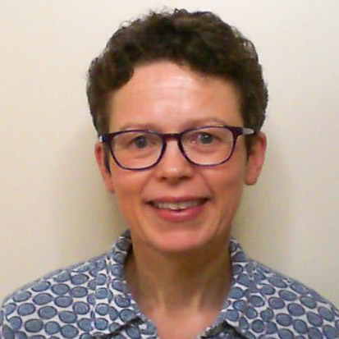
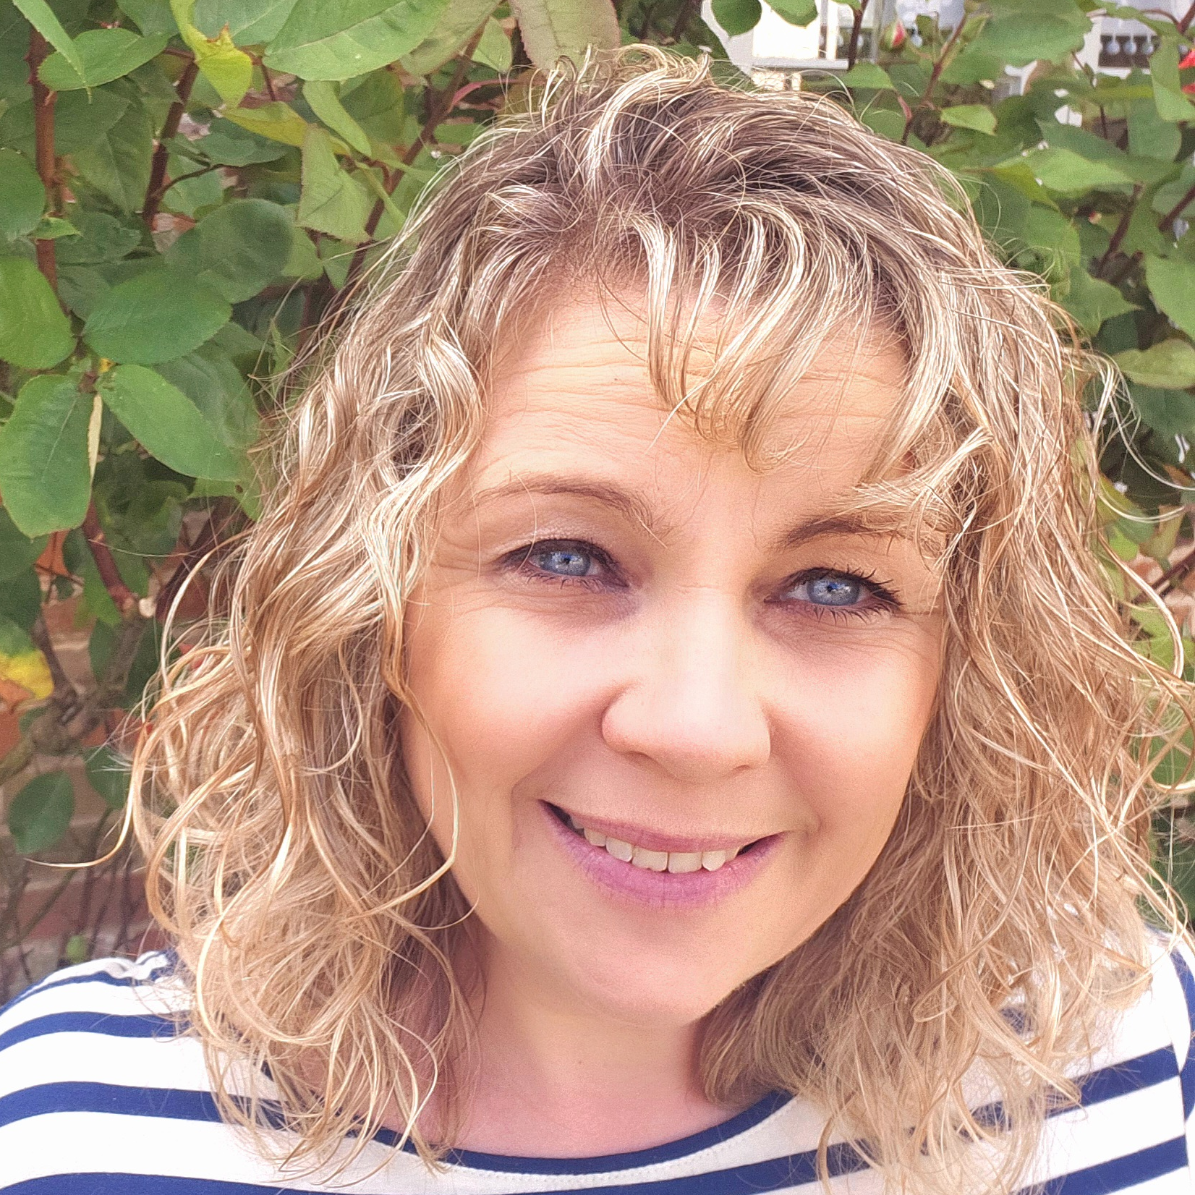
Speakers, Panel Members, Facilitators and Volunteers
Helen Clemow has worked as a Knowledge Specialist in the Healthcare Library for ten years.
Her role is finding evidence to help answer clinical and non-clinical queries. She is passionate about equality, diversity and inclusion (EDI), staff wellbeing, health inequalities, and how they can play a part in staff retention.
She has a special interest in supporting staff going through perimenopause having experienced the perfect storm of perimenopause, while juggling teenagers and elderly parents.
She hopes to use her information skills to help ensure that younger people are prepared for perimenopause better than her generation were, as well as supporting staff going through it currently, no matter what their gender or cultural background, and helping their colleagues/allies find ways to support them better in the workplace and home.
Nicola Boardman has been a Midwife since 1999, practicing for many years as a clinical hospital Midwife before exploring other roles within Maternity Services.
She is now the Lead Professional Midwifery Advocate and Retention lead within maternity, where her focus is on striving to ensure the experience of Midwives who work at SFT is the best it can be, and prioritising staff wellbeing.
She has always been passionate about Women’s health – both the Women who use Maternity services, and the women who work within it.
She became a Menopause Champion in the Trust in 2022 as part of her commitment to staff wellbeing, and is passionate about supporting, informing and signposting for Women to empower them to navigate their Menopause journey with slightly more confidence - and in the knowledge that they are not alone.

Slide 5
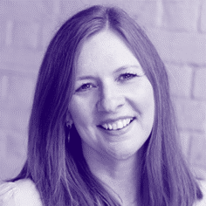
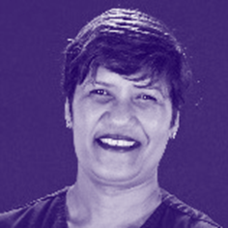
Speakers, Panel Members, Facilitators and Volunteers
Jo Ibbott is an Executive Leadership Coach. She became curious about something she observed happening to women and their careers in midlife which led her to focus on the impact of peri/menopause and train as an Executive Menopause Coach.
Jo works with women and workplaces helping them understand menopause and its impact so they can make positive change.
She also founded the Facebook Group 'What the Fog? Understanding Perimenopause & Menopause' which supports those navigating menopause with good information, guidance, community and advice.
Champika Dona qualified as a nurse in Sri Lanka in 1996. Seeking to expand her knowledge and experience, she moved to the UK in 2005. As a dedicated nursing professional, she completed her Master’s degree and won the Award of CIM Excellence in 2021. In the same year, she also received the Health and Social Care Award as a BAME Apprentice.
A high-profile, compassionate leader and role model, Champika has demonstrated an unwavering commitment to patient care, continuously inspiring those around her to achieve excellence. Recently, Champika joined the SFT as Deputy Divisional Head of Nursing for the Surgical Division.
Champika fervently believes in the power of diversity and inclusiveness in the workplace. She actively promotes these principles, utilising her exceptional skills to foster a harmonious and collaborative work environment. Her efforts have not only enhanced team cohesion but have also resulted in a deeper understanding and appreciation of cultural differences among colleagues.

Slide 6
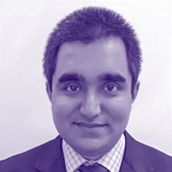
Speakers, Panel Members, Facilitators and Volunteers
Dr Vikram Talaulikar is a Specialist in Reproductive Medicine at University College London Hospitals NHS Foundation Trust and Hon. Associate Professor in Women’s Health at the University College London.
He graduated in medicine in India in 2003 and completed postgraduate degree in obstetrics and gynaecology in 2007.
He is a fellow of the Royal College of Obstetricians and Gynaecologists and completed PhD degree at St. George's University of London in 2016.
His clinical interests include reproductive endocrinology, polycystic ovary syndrome, recurrent miscarriage, premature ovarian insufficiency, and menopause.
He is a certified ‘menopause specialist’ by the British Menopause Society.
He has published widely in Reproductive Medicine and Menopause. He is a member of the British Fertility Society, European Society of Human Reproduction and Embryology, British Menopause Society, and International Menopause Society.
He runs a busy menopause and PCOS clinic at UCLH and Menopause Clinic London on Harley Street.
He is a Principal trainer for FSRH Menopause SS module and a trainer for BMS principles and practice of menopause care programme.

Slide 7
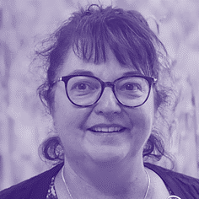
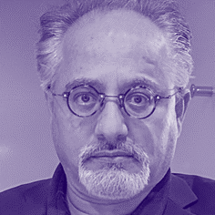
Speakers, Panel Members, Facilitators and Volunteers
Ms Annie Hawkins BSc MRCOG MIPM DFSRH works as an NHS Consultant at Salisbury District Hospital, having worked in Obstetrics and Gynaecology for 30 years.
She is a British Menopause Society (BMS) Accredited Menopause Specialist and previous member of the BMS medical advisory council. She has been a member of the BMS for 25 years.
Ms Hawkins has a special interest in female reproductive hormones, including the treatment of pre-menstrual syndrome, premature ovarian insufficiency, menopause and sub-fertility. Her 3 years in research was in how androgens affect sexuality in women.
Harjinder Bahra is Head of Inclusion and Wellbeing at SFT.
He trained as a barrister and has dedicated over 20 years to championing equality, diversity, inclusion, and human rights within the NHS.
He passionately believes in the transformative potential of compassionate and inclusive leadership to enhance staff wellbeing and the lives of the people they care for.
He's a passionate foodie who's currently experimenting with roasting different types of coffee beans at home.

Slide 8
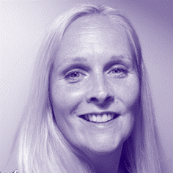
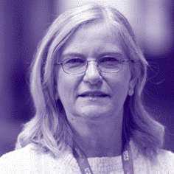
Speakers, Panel Members, Facilitators and Volunteers
Andrea Yeadon is Level 7, CIPD qualified, and started her career in HR because she wanted to make a positive difference to the working lives of people and bring the ‘human’ into Human Resources.
Thankfully, we now talk about our People function, demonstrating that we appreciate the value of our people.
She has experience of working in both private and public sectors across a range of organisations using a strategic approach to support organisational success whilst also ensuring a people centric focus.
It’s a pleasure to be supporting this event for Inclusive Wellbeing and joining others in the sharing of knowledge so that people can bring their whole selves to work, and we can together create a working environment where everyone feels they belong.
Jo Broom has 40 years' experience of working in the NHS and other health related organisations.
She is a former Nurse and Midwife and has always lived and worked in and around Salisbury.
Both of my children were born at the hospital and my three grandchildren.
She is actively involved in the local community and my hobby is baking.

Slide 9
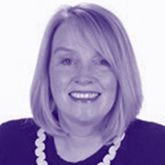
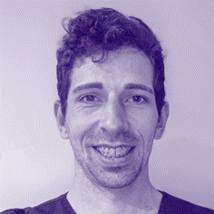
Speakers, Panel Members, Facilitators and Volunteers
Judy Dyos joined the Trust in 2020 from the Isle of Wight NHS Trust where she was formerly Deputy Director of Nursing. Prior to that she was the Lead for Clinical Assurance and Quality Governance at Southampton University Hospital.
Judy’s extensive nursing background has been predominantly based in Intensive care at Southampton University Hospitals and Guys and St Thomas’, she holds an MSc in Advanced Critical Care Practice and a post Graduate Certificate in Research from Kings College London.
Judy completed an internship with the National Institute in Research, undertaking primary research related to critical care. She also worked at the University of Southampton for 2 years as a visiting lecturer in the Faculty Heath Science, tutoring under and post graduate student nurses.
She is focused on continuous quality improvement to ensure the best possible care is provided to the people that use our services.
James Anderson is a Clinical Specialist Physiotherapist working in Orthopaedics and is also the Team Lead Physiotherapist for the inpatient Orthopaedic therapy team.
We're a team of 20 staff of varied age, gender and experience.
He started working at Salisbury District Hospital in 2020 having previously studied and worked in London, Cambridgeshire and for a professional football club.
He lives locally in Salisbury with his wife and 18-month year old daughter. His hope is that, when the time comes, they will benefit from greater awareness of the perimenopause from employers and society.

Slide 10
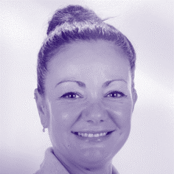
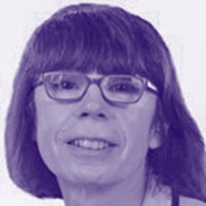
Speakers, Panel Members, Facilitators and Volunteers
Emma Smith is a Gym Team Leader at Odstock Health and Fitness Centre. She has been in general health and fitness with 8 years’ experience teaching Yoga.
She then spent several years working with Cardiac and Cancer patients and specialising in exercise and fitness with those who have specific health issues including Diabetes, Joint problems or replacements, COPD, Anxiety/Depression and Low Back Pain.
More recently having finished a Chartered institute for the Management of Sport and Physical Activity recognised “Training Menopausal and Perimenopausal Women” CPD qualification in working with those who have symptoms of the Perimenopause and menopause.
Tania Baker is a Non-Executive Director on the Salisbury NHS Foundation Trust.
She was CEO at Dr Foster the health analytics company until March 2015.
She played a key role in developing the business especially in international markets which led to the sale of the business to Telstra Health. Prior to that Tania held senior appointments in the private healthcare sector and was Commercial Director in the team that set up the Aviva Health insurance business.
Since leaving Dr Foster she has been working with Aviva Health and Vitality Health to establish a new joint venture to commission healthcare using a value-based approach.
She lives in Fordingbridge with her family.

Slide 11
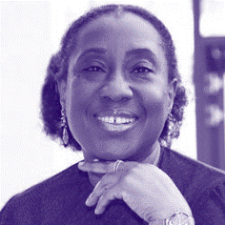
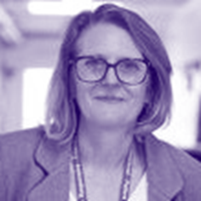
Speakers, Panel Members, Facilitators and Volunteers
Bukky Ayoade has a 35+ year background in pharmacy.
Majority of her working career has been as a consultant within Medical Affairs at blue chip pharmaceutical companies.
Her special interests are women’s health specifically the menopause and lifestyle medicine.
She is responsible for delivery and launch of NHSE menopause resources to support our workforce: guidance documents, e-learning modules, community of Practice & providing help to organisations to embed menopause support & culture in the NHS.
Bukky is a certified health coach and has developed a unique coaching programme to help midlife women going through the menopause transition.
Jo Rowntree started as Head of Occupational Health at SFT in January 2023.
With over 15 years’ experience in OH in both NHS and the private sector, she has gained a wealth of knowledge and experience on supporting women with menopause in the workplace.
She is excited to be involved in the Summit to raise awareness of this important topic with SFT colleagues.

Slide 12
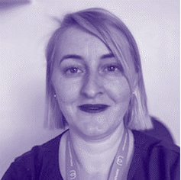
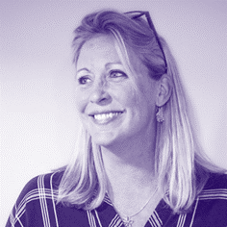
Speakers, Panel Members, Facilitators and Volunteers
Laura Soul trained as a teacher and currently works as Electronic Staff Record (ESR) Administration Manager and Chair for the Women’s Network.
She has worked in the Trust for over 5 years in different roles that allowed her to get a better understanding of how diverse, challenging and amazing working in the NHS is.
She is passionate about change and creating a culture of support, understanding and kindness.
She speaks 6 languages and loves reading history books.
Dr Kate Jenkins is a Consultant Clinical Psychologist and has worked at Salisbury District Hospital for the last 18 years.
Her clinical specialities include Cancer and ITU, but she has supported staff throughout her career and has had a specific role in Staff Wellbeing for the last three years.

Slide 13
Menopause Champions at SFT – What we do.
Menopause Champions at SFT
The work of Menopause Champions within the NHS nationally has been shown to help retain some of the most experienced and knowledgeable staff.
There is currently a group of 14 Menopause Champions based in various departments across the Trust who support staff and their managers in person and/or via email by signposting them to appropriate resources. They also help to foster a supportive environment so that the needs of staff going through perimenopause are considered.
Some examples of projects they have been involved in are the new uniform dresses, Menopause Summit, and Staff Wellbeing Portal.
‘Tea and Talk’ drop-in sessions
Menopause Champions hold alternative month “Tea and Talk” drop-in sessions from 12-2pm in the Healthcare Library. (The next one is on the 10th July.) They also plan to hold talks via Teams in the lunch hour so that more staff can join in from their desk.
Feedback regarding the drop in sessions has been positive and included:
“Wellbeing is so important and to know my menopause is supported at work with information resources and other female colleagues, I find really valuable.”
“Friendly compassionate support and practical help.”
“I feel now like I’m not crazy and most importantly not alone! Thank you!”

Slide 14
How to become a Menopause Champion at SFT
We are always looking for new Menopause Champions to join our network.
Anyone interested in becoming just needs to:
Complete the 30-minute NHS Menopause Awareness Training (available via MLE) https://salisbury.kallidus-suite.com/learn/#/course/0f5905ba-25a8-4256-8180-6fefde2b5c65
Readily talk about perimenopause and menopause at work to break down stigma.
Highlight/signpost to support available at SFT, locally and nationally.
Attend Menopause Champion meetings to keep knowledge up-to-date and share how things are for colleagues impacted by menopause in their work areas.
If you are interested or would like further details, please email: sft.menopausechampion@nhs.net

Slide 15
Welcome to the Healthcare Library
The Healthcare Library is situated in Block 29, SDH South.
Membership is available for all staff, students and volunteers, and includes 24/7 access to quiet study space and the opportunity to borrow up to 12 books.
A wide range of electronic resources are available which include access to e-books and articles, databases, and point of care decision making tools with an NHS OpenAthens account. Register for one here.
The Library also provides an evidence and literature search service on clinical and non-clinical topics, and 1 to 1 training on accessing e-resources.
A tailor-made resource list and current awareness bulletin service is available too.
The Library’s Wellbeing Zone includes nationally acclaimed mood boosting fiction, wellbeing titles, colouring and a jigsaw. There is also a dedicated space for each Staff Network with relevant resources.
For further details email: sft.library.office@nhs.net
‘Books are humanity in print’
Barbara Tuchman
‘The only thing that you absolutely have to know is the location of the library’
Albert Einstein

Slide 16
Acknowledgements and Thanks
SFT acknowledges and thanks the following individuals, teams and organisations for their support and passion to make this Menopause Summit possible.
Special thanks to:
Helen Clemow for her exceptional passion, dedication and leadership in coordinating and driving the summit's agenda to make this summit a reality.
Harjinder Bahra for project managing the summit, handling logistics and publicity materials.
Nicola Boardman for her calming nature, insightfulness, passion and for co-chairing the summit.
Laura Soul for her unwavering energy and infections ‘can do it’ attitude, co-chairing and summary of the day.
Jo Rowntree for her invaluable insights to ensure that the summit took a holistic approach to menopause awareness and support for all staff.
Jo Broom for her wisdom and being a trusted sounding board and a champion for the cause.
Helen Dobson for guidance and allowing generous protected time to ensure that the summit happened.
Inez Szczepanska for her creative talents in filming and photographing the summit.
Ben Thompson-Jones for his admin support and charm!
Thanks to our speakers, panel members, facilitators and volunteers:
Judy Dyos
Jo Ibbott
Ms Annie Hawkins
Emma Smith
Bukky Ayoade
Champika Dona
Dr Vikram Sinai Talaulikar
James Anderson
Andrea Yeadon
Dr Kate Jenkins
Tania Baker
Sophia Strong-Sheldrake
Cathy Polley
Healthcare Library Team
Communications Team
Education Centre
Catering Team
Special Thanks for their kind donation of goody bags, products and booklets:
Stars Appeal Charity
The Yes Yes Company Ltd
Menopause Support

Slide 17
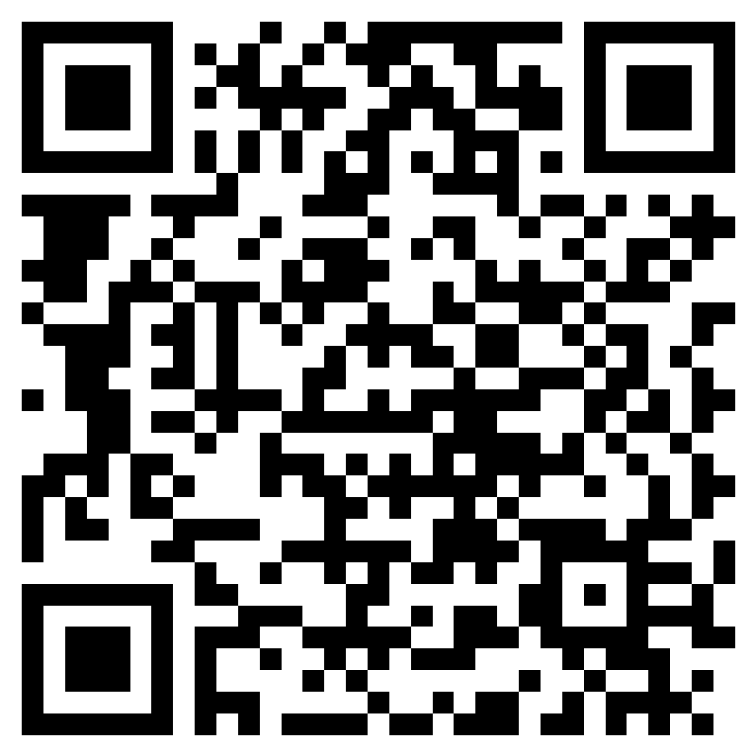
Menopause Summit Feedback and Wishlist Survey
Please sharing your thoughts and suggestions so that together we can make SFT a more supportive workplace for all perimenopausal staff going forward.
https://forms.office.com/e/0MjM1FBKRt

Slide 18
Menopause Support for keeping us supplied with “Understanding Menopause” booklets free of charge.
Stars Appeal for their generous donation of goodie bags at very short notice.
Yes Yes Ltd for their generous supply of gynaecologist and dermatologist approved lubricant samples for the Summit and future menopause related events.

